Slide 1
Life Insurance Need Calculator 2.0
By Gopalakrishnan Kumar, MTech IIT-Bombay,
Freelance Data Science Consultant
LinkedIn: Profile Link : https://www.linkedin.com/in/gopalakrishnankumar-a73301110/
Github:https://www.krishgopal.kumar86@gmail.com
Kaggle URL- https://www.kaggle.com/gopalkk2

Slide 2
Google Colab URL
https://colab.research.google.com/drive/1UOB8DfOcFUdrn6muv6v7sR_qMZfvU8v4?usp=sharing

Slide 3
Introduction
Life insurance plays a crucial role in ensuring financial protection for families in the event of an unexpected loss of income due to the death of a primary earning member. With rising living costs, increasing financial obligations, and long-term family responsibilities, determining the appropriate life insurance coverage has become a critical financial planning decision.
Traditional life insurance estimation methods often rely on simple rules such as purchasing insurance equal to 10–15 times annual income. However, such rules do not always account for individual financial circumstances, liabilities, future financial goals, and existing assets. As a result, many individuals remain either underinsured or overinsured.

Slide 4
Introduction
The Life Insurance Need Calculator 2.0 project introduces a data-driven approach to estimating optimal life insurance coverage by integrating multiple financial components such as income replacement, liabilities, future expenses, and existing financial resources. The model leverages Python-based analytics and data visualization techniques to simulate financial profiles and estimate the insurance coverage required for individuals across different demographic segments.
This research project also applies multiple visualization techniques including histograms, bar charts, stacked bar charts, and combined stacked bar charts to analyze the distribution of insurance needs across populations and identify patterns that can support financial planning decisions.
The objective of this project is to develop an analytical framework that helps individuals, financial planners, and insurance companies determine appropriate life insurance coverage using quantitative financial modeling.

Slide 5
Objectives of the Study
The primary objectives of the Life Insurance Need Calculator 2.0 project are as follows:
To develop a financial model for estimating optimal life insurance coverage.
To analyze how income, liabilities, savings, and future expenses affect insurance needs.
To simulate financial profiles of individuals across different demographic segments.
To visualize insurance coverage requirements using advanced data visualization techniques.
To generate insights that support data-driven financial planning and insurance product design.

Slide 6
Importance of Life Insurance Planning
Life insurance serves as a financial safety net that protects dependents from financial hardship when the primary income earner passes away. The proceeds from a life insurance policy can be used to:
Replace lost income
Pay off outstanding debts
Fund children's education
Cover daily living expenses
Support long-term financial security for family members

Slide 7
Importance of Life Insurance Planning
Despite its importance, many individuals lack adequate life insurance coverage due to limited financial awareness or incorrect estimation methods.
A comprehensive life insurance planning model must consider several financial variables, including:
Income replacement needs
Outstanding liabilities
Future family obligations
Current savings and investments
Existing insurance policies
The Life Insurance Need Calculator 2.0 integrates all these components to produce a more accurate estimate of the required life insurance coverage.

Slide 8
Dataset Description
Since real-world financial datasets are often confidential, this project uses a simulated dataset representing 1000 individuals. The dataset was generated using Python to reflect realistic financial characteristics.
Variable | Description
Age Group | Demographic age category
Annual Income | Individual yearly earnings
Income Replacement Years | Number of years income must support dependents
Liabilities | Outstanding loans and financial obligations
Future Expenses | Estimated long-term expenses
Savings | Existing financial assets
Existing Insurance | Current life insurance coverage
The simulation approach ensures that the dataset reflects a realistic distribution of financial profiles
across the population.

Slide 9
Methodology
The Life Insurance Need Calculator 2.0 model estimates insurance coverage requirements using a structured financial framework.
The Life Insurance Need Calculator 2.0 model estimates insurance coverage requirements using a structured financial framework.
5.1 Income Replacement Model
The most important component of life insurance planning is income replacement, which ensures that dependents can maintain their standard of living after the policyholder's death.
The formula used in the model is:
Income Replacement Need = Annual Income × Income Replacement Years
For example, if an individual earns $50,000 annually and wants to replace income for 20 years, the required income replacement amount would be:
$50,000 × 20 = $1,000,000

Slide 10
Methodology
5.2 Liabilities Coverage
Outstanding financial obligations must also be considered when calculating insurance needs. These include:
Home loans
Personal loans
Education loans
Credit card debt
Life insurance proceeds can help family members pay off these liabilities and avoid financial stress.

Slide 11
Methodology
5.3 Future Financial Goals
Future financial commitments such as children's education and marriage expenses must also be accounted for. These expenses often represent large financial requirements that families may struggle to meet without proper insurance planning.
5.4 Available Financial Resources
Existing financial assets reduce the total insurance coverage required. These resources include:
Savings accounts
Investment portfolios
Retirement funds
Existing life insurance policies

Slide 12
Final Life Insurance Need Formula
The final life insurance requirement is calculated as:
Recommended Life Insurance Coverage =
(Income Replacement + Liabilities + Future Expenses) − (Savings + Existing Insurance)
If the result is negative, the individual already has sufficient financial coverage.

Slide 13
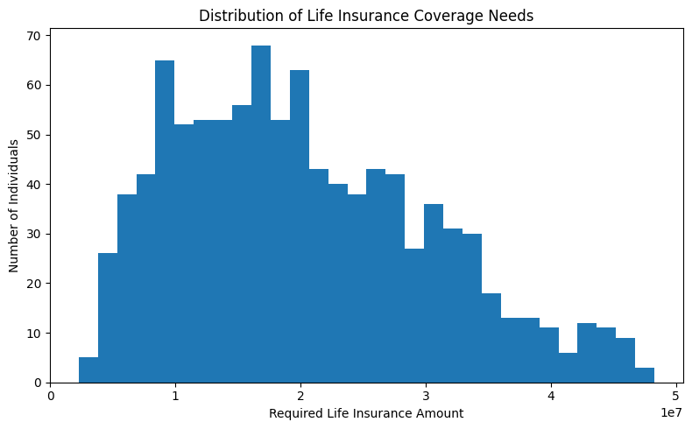
Data Visualization

Slide 14
Data Visualization and Analytics
To better understand the distribution of insurance needs, multiple visualization techniques were used in this project.
7.1 Histogram Analysis
The histogram displays the distribution of life insurance coverage needs across individuals.
Key observations include:
Most individuals require moderate levels of insurance coverage.
A smaller portion of individuals require extremely large insurance policies due to higher income levels and financial obligations.
The distribution is right-skewed, meaning a small percentage of individuals have very large insurance needs.
This insight is important for insurance companies when designing product offerings.

Slide 15
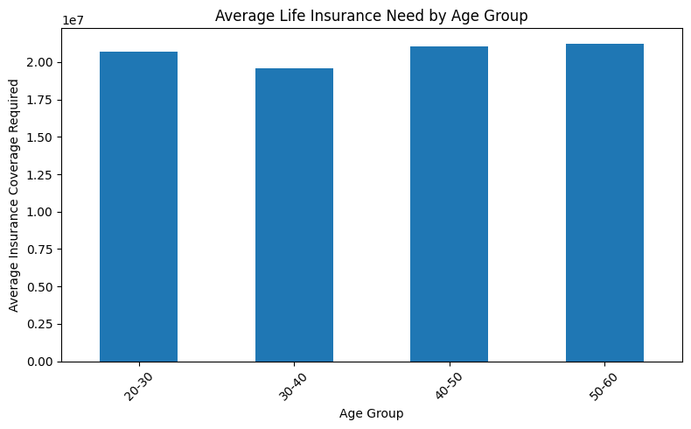
Data Visualization

Slide 16
Data Visualization and Analytics
7.2 Bar Chart Analysis
The bar chart compares average insurance coverage needs across age groups.
Key observations:
Younger individuals typically require higher coverage due to longer financial responsibilities.
Middle-aged individuals often show the highest coverage requirements because of mortgages and family responsibilities.
Older individuals generally require lower coverage as liabilities decrease.

Slide 17
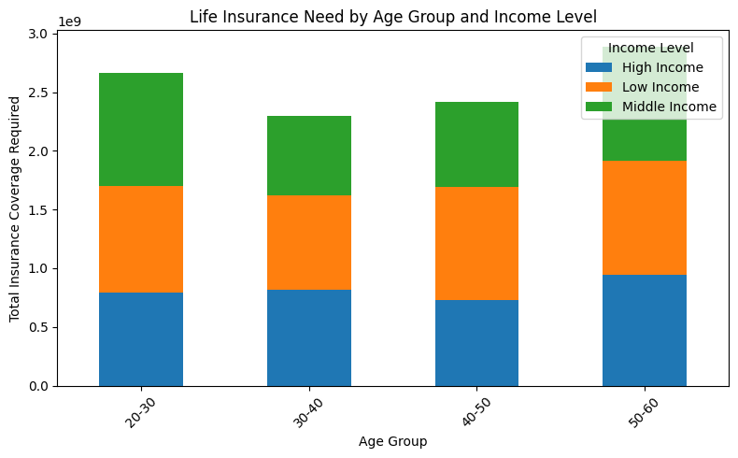
Data Visualization

Slide 18
Data Visualization and Analytics
7.3 Stacked Bar Chart Analysis
The stacked bar chart breaks down insurance needs across age groups and income levels.
This analysis reveals:
High-income individuals require significantly larger insurance coverage.
Middle-income groups form the largest customer segment for insurance companies.
Insurance demand varies significantly across demographic segments.

Slide 19
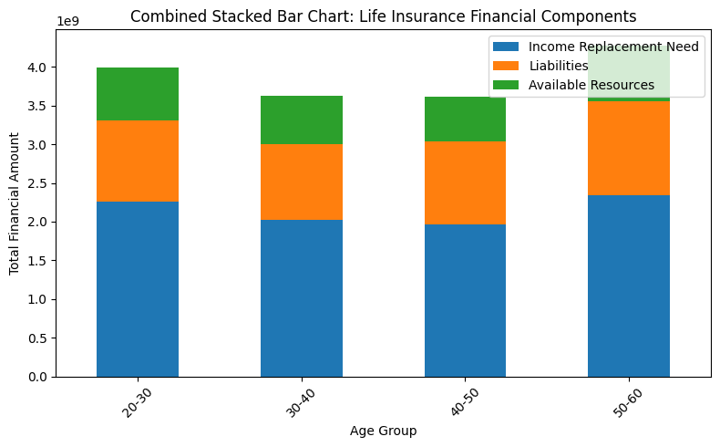
Data Visualization

Slide 20
Methodology
7.4 Combined Stacked Bar Chart Analysis
The combined stacked bar chart compares income replacement needs, liabilities, and available resources across age groups.
This visualization highlights:
Income replacement is the largest component of insurance needs.
Liabilities peak in middle-age groups due to home loans and financial commitments.
Available resources increase with age due to savings accumulation.

Slide 21
Business Applications
The Life Insurance Need Calculator 2.0 has several practical applications in the financial services industry.
Financial Planning
Financial advisors can use the model to estimate appropriate insurance coverage for clients.
Insurance Product Design
Insurance companies can analyze coverage demand patterns and design suitable insurance policies.
Customer Segmentation
Analytics can help insurers identify different customer segments based on income, age, and financial responsibilities.

Slide 22
Business Applications
Risk Assessment
The model helps insurers evaluate the potential risk exposure associated with policyholders.
Digital Insurance Platforms
The calculator can be integrated into online financial planning tools to provide personalized insurance recommendations.

Slide 23
Key Insights
1. Income replacement is the largest component of life insurance coverage needs.
2. Middle-aged individuals typically require the highest life insurance coverage.
3. Financial liabilities significantly increase insurance requirements.
4. Higher income levels lead to substantially greater insurance coverage needs.
5. Available savings and investments reduce insurance dependency.
6. Insurance demand varies significantly across demographic segments.
7. Data-driven financial planning improves insurance coverage accuracy.
8. Visualization techniques help identify patterns in financial protection needs.
9. Personalized insurance calculators improve financial decision-making.

Slide 24
Conclusion
Life insurance is an essential financial planning tool that protects families from financial uncertainty. However, determining the correct amount of coverage requires careful analysis of income, liabilities, future obligations, and existing financial resources.
The Life Insurance Need Calculator 2.0 project demonstrates how data analytics and financial modeling can be used to estimate insurance coverage requirements more accurately. By integrating multiple financial components into a unified framework, the model provides a comprehensive estimate of life insurance needs.
The use of data visualization techniques enhances understanding of financial risk patterns and enables more effective decision-making for individuals and insurance providers.
Ultimately, data-driven insurance planning can improve financial security, optimize insurance product offerings, and support long-term financial stability for families.

